Slide 1
Team 6 Project Proposal
Team Members
Carlos Vasquez, Chiayi Tsai, Kartiki Saraf, Miles Beler, Rozz Garrido
Saturday, September 11, 2021

Slide 2
Project Proposal Summary
Project Title: U Game On Site
Description: A gaming website where you can access a variety of video games. Click on the video game content tile of your choice to play. The site will have a search, sort, and filter option. Some games will be playable. Video games will be the 2nd API.
User Story: As a user, I want to see tiles of games so that I can choose what I want to play.
Acceptance Criteria:
GIVEN tiles of games
WHEN I go to the site
THEN I can see all the games tiles
Wireframe: Link
APIs To Be Used: Free-To-Play Games API: https://www.freetogame.com/api-doc
Breakdown of Tasks:
Rozz- Wireframe, UI layout
Millie – User Story, UI layout
Carlos – UI layout, game site UI, testing
Miles – breakdown of tasks, UI layout
Kartiki – APIs

Slide 3
Project Title - U Game On Site
Project Description:
A gaming website directory where you can access a variety of video games.
Click on the video game content tile of your choice to play.
The site will have a search, sort, and filter option.
Some games will be playable.
Video game(s) will be the 2nd API.

Slide 4
Wireframe
Site Title (LOGO)
Navigation/Search Bar
Current Selected Filters
Photo of game/GIF preview
Photo of game/GIF preview
Photo of game/GIF preview
List of Filters
Game Description / Download Link / Share Button
Game Description / Download Link / Share Button
Game Description / Download Link / Share Button
Multiplayer
Single Player
Photo of game/GIF preview
Action/Adventure
Strategy
Game Description / Download Link / Share Button
https://docs.google.com/presentation/d/1vBgvJzZPhkXUwlxqPrkcK6V41Fr4qVrydo9i4qbCpsM/edit#slide=id.gebd68e0fc7_0_35

Slide 5
Game Title
Wireframe
*Page when game is selected
PHOTO OF GAME
Brief description/Gameplay Screenshots.

Slide 6
User Flow Diagram
GAMING HOMEPAGE
Game Title
User is presented with the info page of the selected game. They are presented with the title, an enlarged photo, a game description, as well as gameplay screenshots.
Selected filter(s)
Games arranged according to filter(s)
*user clicks on a game
Photo
*user clicks on filter(s)
Info/Download
User starts off at homepage, where they see games, filters and search/navigation bar.
Depending on what filters were chosen, games will arrange to fit criteria.For example, if “Multiplayer” was chosen, then multiplayer games will show at the front of the list.
*User clicks “Download”
*user clicks on a game
*user utilizes search box
GAMING SITE
Searching...
A list of game(s) will populate as a result of user’s search criteria. User will see “No Results…” if nothing matches database.
Game Results
User will be taken to official game site in order to proceed with download.

Slide 7
User Stories
User Story 1
As a user, I want to see tiles of games so that I can choose what I want to play.
Acceptance Criteria
GIVEN tiles of games
WHEN I go to the site
THEN I can see all the games tiles
User Story 2
As a user, I want to filter games’ tiles by its platform, genre, graphics, combat, gameplay, setting and tags so that I can find my specific game.
Acceptance Criteria
GIVEN some filter options (platform, genre, graphics, combat, gameplay, setting and tags)
WHEN I select either one of them or multiple filter options
THEN it shows me a result page with the game which meets my selections

Slide 8
User Stories (contd)
User Story 3
As a user, I want to select a game to play so that I can know if I like it or not.
Acceptance Criteria
GIVEN all tiles can be clicked
WHEN I click a tile of game
THEN it shows me the selected game page
THEN I can click the play button to play the game
User Story 4
As a user, I want to play the Pokémon game on the site so that I can have fun.
Acceptance Criteria
GIVEN me a Pokémon game site
WHEN I click play game button
THEN I can play the Pokémon game

Slide 9
APIs To Be Used
Gaming API Site:
https://public-apis.io/free-to-play-games-database-api
API Documentation:
https://www.freetogame.com/api-doc
With Cross-origin resource sharing features, access to API via RapidApi
https://rapidapi.com/digiwalls/api/free-to-play-games-database

Slide 10
Free-To-Play Games Database API Endpoints
Live games list
GET https://www.freetogame.com/api/games
Games by platform
GET https://www.freetogame.com/api/games?category=shooter
Insert platform, eg: pc, browser or all
Games by category or tag
GET https://www.freetogame.com/api/games?sort-by=alphabetical
Insert game category or tag, eg: mmorpg, shooter, pvp, mmofps and more.
Insert platform, eg: pc, browser or all

Slide 11
Free-To-Play Games Database API Endpoints (contd)
Sort games by release date, alphabetical or relevance
GET https://www.freetogame.com/api/games?sort-by=alphabetical
Insert sort by, eg: release-date, popularity, alphabetical or relevance
Games by platform & category & sorted
GET https://www.freetogame.com/api/games?platform=browser&category=mmorpg&sort-by=release-date

Slide 12
Free-To-Play Games Database API Endpoints (contd)
Filter Games by multiple tags for personalized results
GET https://www.freetogame.com/api/filter?tag=3d.mmorpg.fantasy.pvp&platform=pc
Insert tag, eg: mmorpg, shooter, pvp, mmofps and more. Optionally you can also use the "platform" and "sort" parameters
Return details from a specific game
GET https://www.freetogame.com/api/game?id=452
Insert game id

Slide 13
API Limits and Responses
Rate Limits
Please avoid doing more than 4 requests per second.
Responses
200: Success
404: Object not found: Game or endpoint not found
500: Something wrong on our end (unexpected server errors)

Slide 14
CSS framework
Google framework material UI - https://material.io/design
or
Bulma - https://bulma.io/

Slide 15
Breakdown of Tasks
Planning Phase
Create user story
Create wireframe
Create user flowchart
Finalize API for project
Finalize CSS for project

Slide 16
Breakdown of Tasks (contd)
Building Phase
Set up directory structure of the project (.html, .css and .js)
Import free games list API to receive data
Validate API works
Set up UI to display games
Set up UX to make page interactable
Clean up and customize UI
Import video games API
Integrate both APIs cleanly on the UI
Set up local storage for user data

Slide 17
Breakdown of Tasks (contd)
Testing Phase
Test application
Deployment Phase
Deploy application
Gold plate the UI and add final features

Slide 18
Breakdown of Tasks (contd)
Create Presentations
Set up slideshow
Set up deployable website from slideshow
Managing Project Cycle
Daily checkups
Management tasks including estimating timeline for tasks
Tracking the status of task completion in GitHub

Slide 19
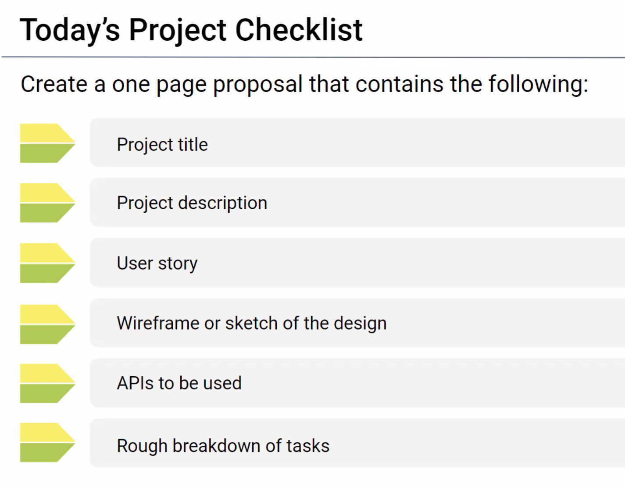
Appendix 1

Slide 20
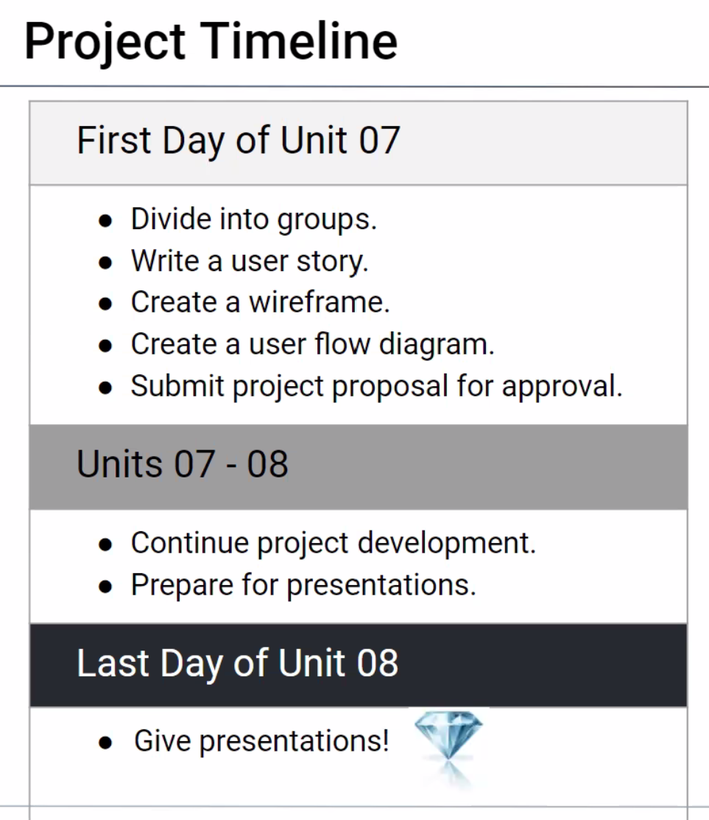
Appendix 2

Slide 21
Team Distribution for the Proposal
Rozz- Wireframe
Millie – User Story
Carlos – Project Description
Miles – breakdown of tasks
Kartiki – APIs to be used

